Slide 1


The Lottery Ticket Hypothesis
汇报人：刘源鑫
2021.4.7

Slide 2
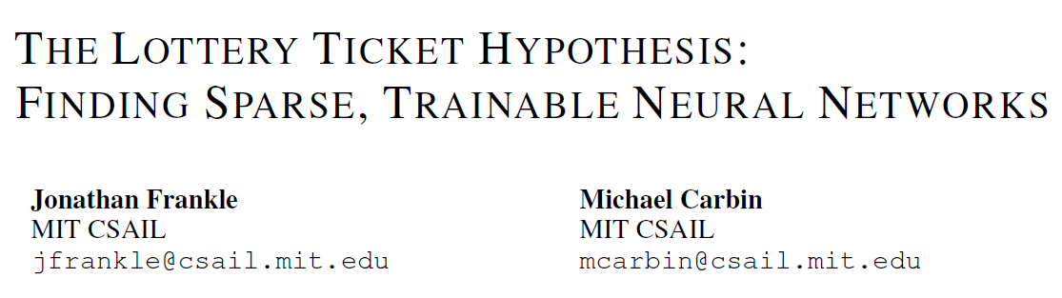
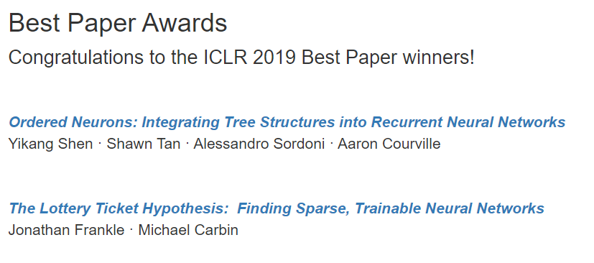
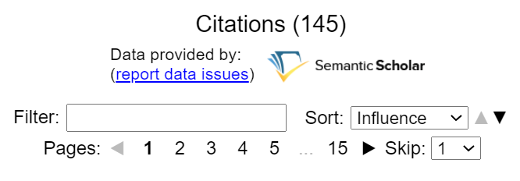
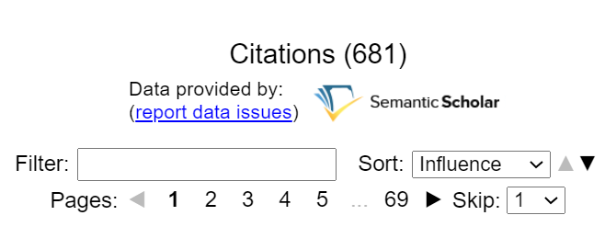
Background

Slide 3
The Lottery Ticket Hypothesis
Train
Compress
Inference
Draw Winning
Tickets
Train
Inference
ICLR 2019

Slide 4
The Lottery Ticket Hypothesis
Train
Train
Train
Definition: Dense, randomly-initialized, neural network contains a subnetwork (winning tickets) that—when trained in isolation—it can match test accuracy of the original network in a similar number of iterations.
Subnetwork
Unstructured
Subnetwork
Structured
Dense Network
ICLR 2019
Notes:
Similar number of iteration强调的是收敛速度，不是实际的训练速度。
即使unstructured Subnetwork经过一些方法处理后，也能实现训练加速

Slide 5
The Lottery Ticket Hypothesis
Iterative Pruning
Trained Model
度量参数重要性
移除不重要参数
否
达到裁剪程度要求？
是
Retrain
停止剪枝

Slide 6
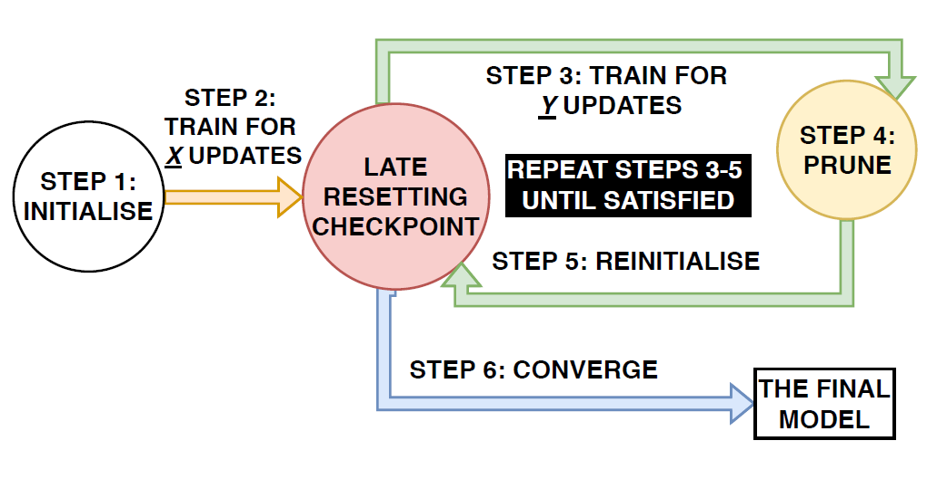
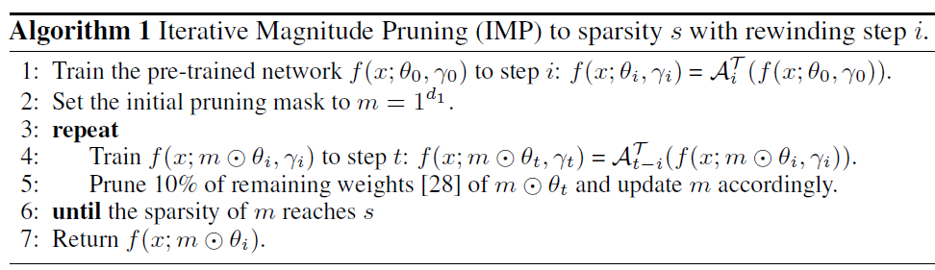
The Lottery Ticket Hypothesis
Find Winning Tickets via Iterative Pruning
Notes:
用Iterative pruning，只是为了证明WT的存在

Slide 7
The Lottery Ticket Hypothesis
Dense Network
Winning Ticket
Random Ticket
ICLR 2019

Slide 8
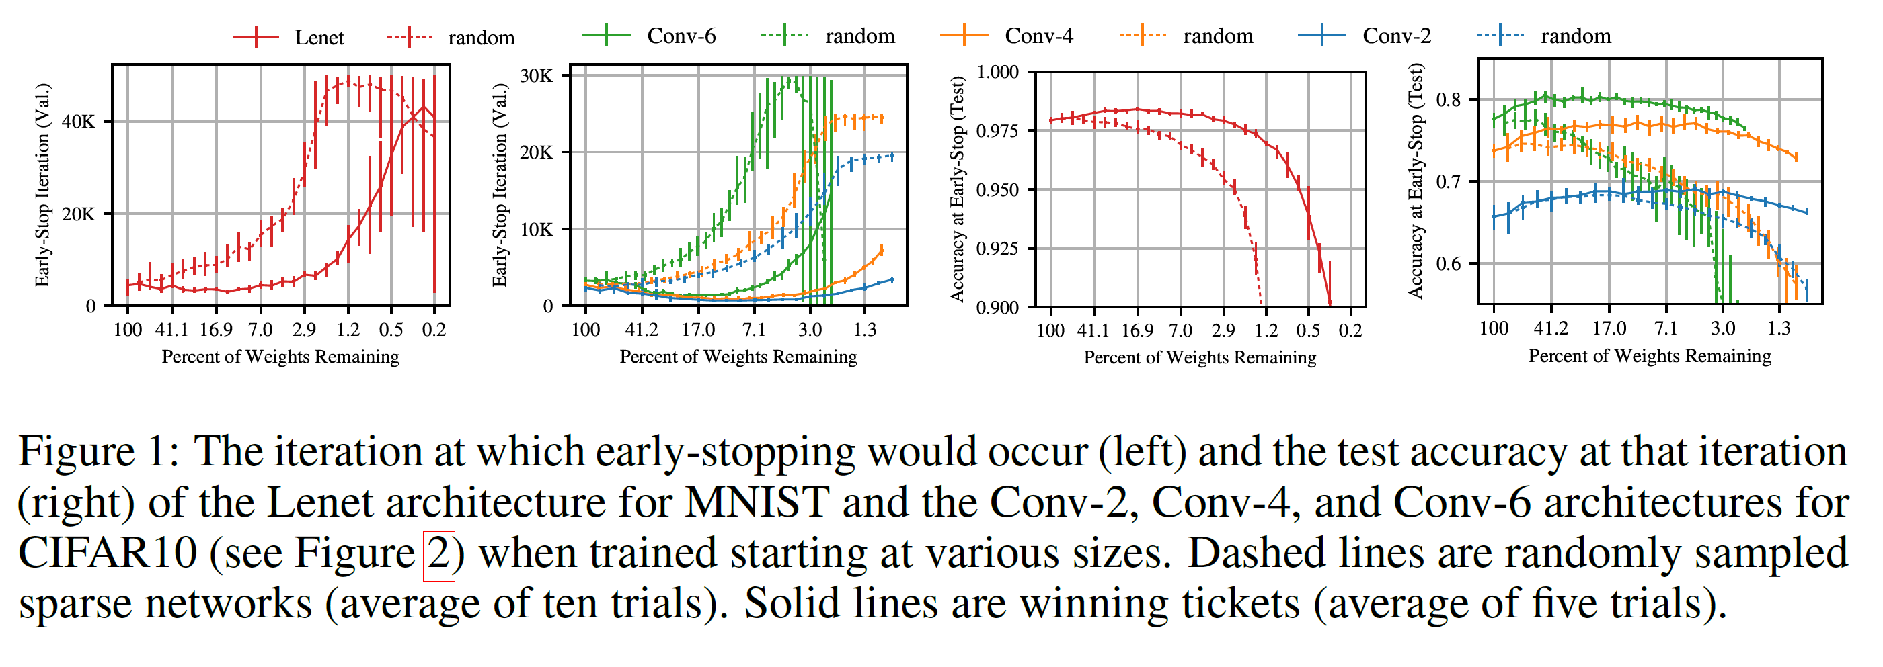
The Lottery Ticket Hypothesis
Winning Tickets vs Random Tickets in Small DNNs
ICLR 2019

Slide 9
The Lottery Ticket Hypothesis
Nontrivial Sparsity
Nontrivial Sparsity
Trivial Sparsity
ICLR 2019
Notes:
判断一个找WT算法的效果，可以看它是否能达到nontrivial sparsity

Slide 10
The Lottery Ticket Hypothesis
Dense Network
Winning Ticket
Random Ticket
Random Init
ICLR 2019

Slide 11
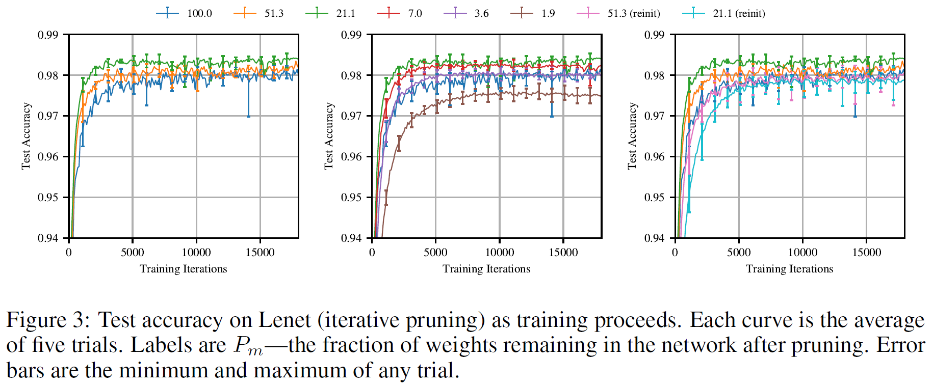
The Lottery Ticket Hypothesis
Winning Tickets vs Random Init in Small DNNs
ICLR 2019
Notes:
Winning ticket比dense network效果还要更好一些
Winning tickets is about both connections and weight values.

Slide 12
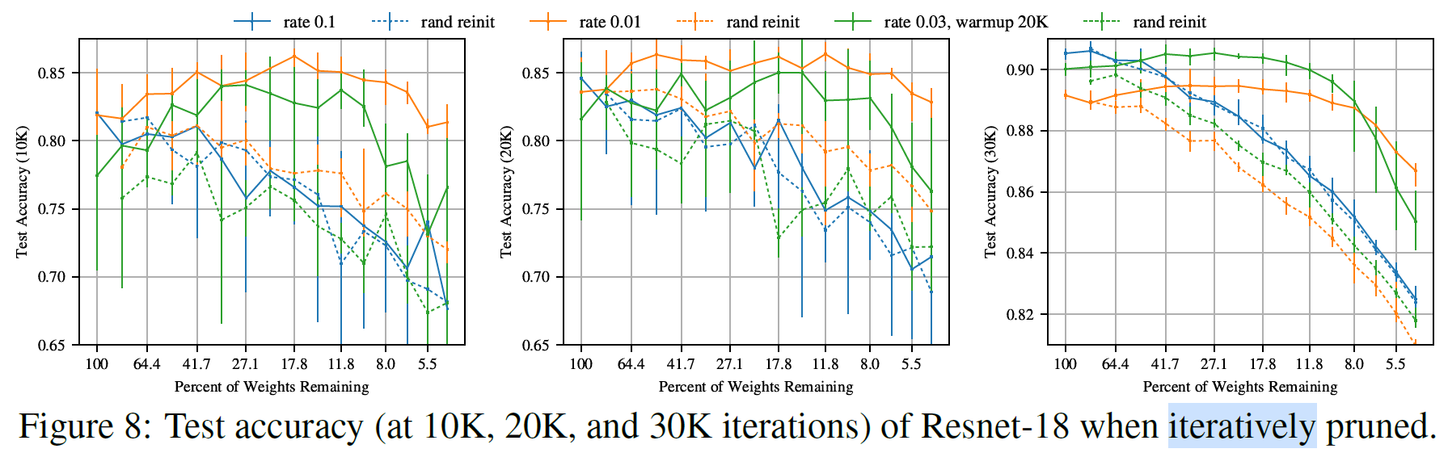
The Lottery Ticket Hypothesis
Winning Tickets vs Random Init in Resnet-18
ICLR 2019
Notes:
Winning ticket是否存在受训练策略的影响，learning rate0.1时不存在。

Slide 13
The Lottery Ticket Hypothesis
Limitations
Sensitive to Optimizer & Learning Rate
Limited to Small DNNs and Datasets
Iterative Pruning is Time-Consuming
ICLR 2019

Slide 14
Research Subfields
The Lottery Ticket Hypothesis
LT in larger models
Speedup Training
LT in other models(GANs, RL, GNN)
Understanding LT
Find winning tickets efficiently
Transfer winning tickets

Slide 15
Research Subfields
The Lottery Ticket Hypothesis
LT in larger models
Speedup Training
LT in other models(GANs, RL, GNN)
Understanding LT
Find winning tickets efficiently
Transfer winning tickets

Slide 16
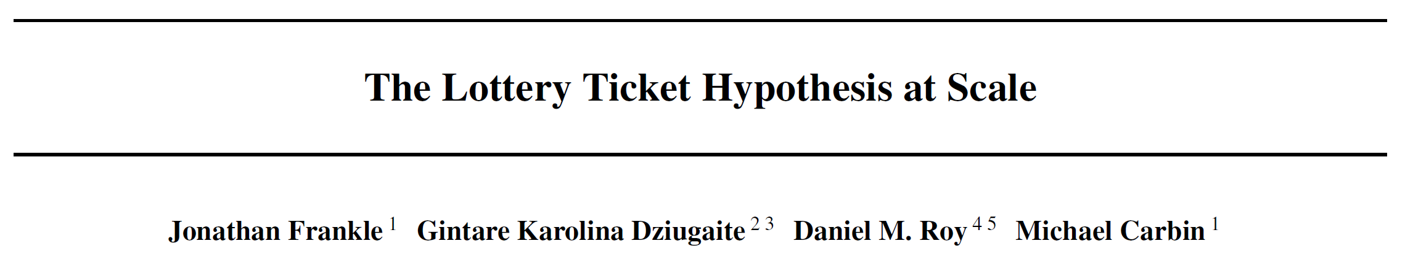
The Lottery Ticket Hypothesis at Scale
Arxiv preprint 2019

Slide 17
The Lottery Ticket Hypothesis at Scale
Late Resetting
Arxiv preprint 2019

Slide 18
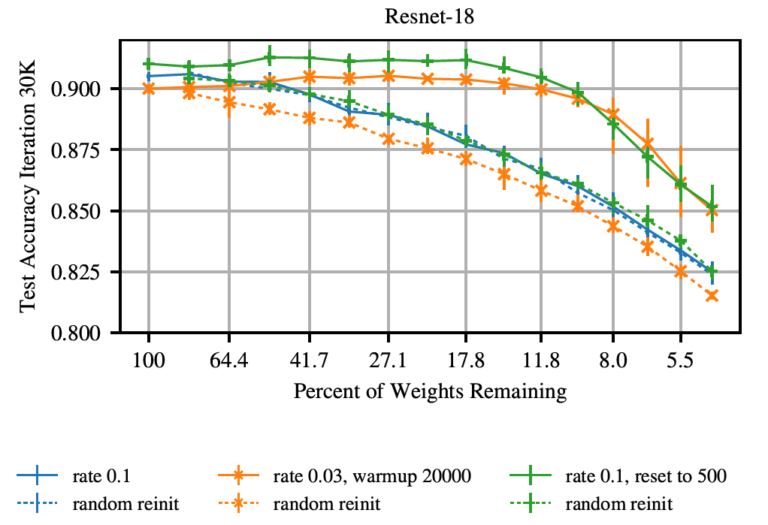
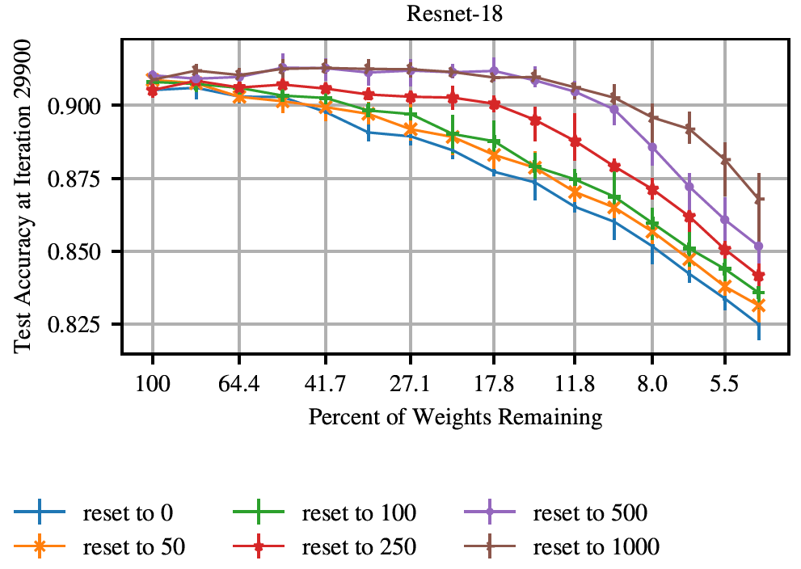
The Lottery Ticket Hypothesis at Scale
Late Resetting
Arxiv preprint 2019

Slide 19
Research Subfields
The Lottery Ticket Hypothesis
LT in larger models
Speedup Training
LT in other models(GANs, RL, GNN)
Understanding LT
Find winning tickets efficiently
Transfer winning tickets

Slide 20
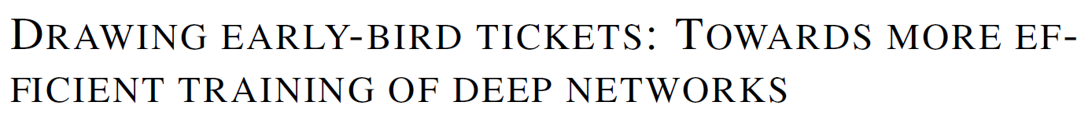
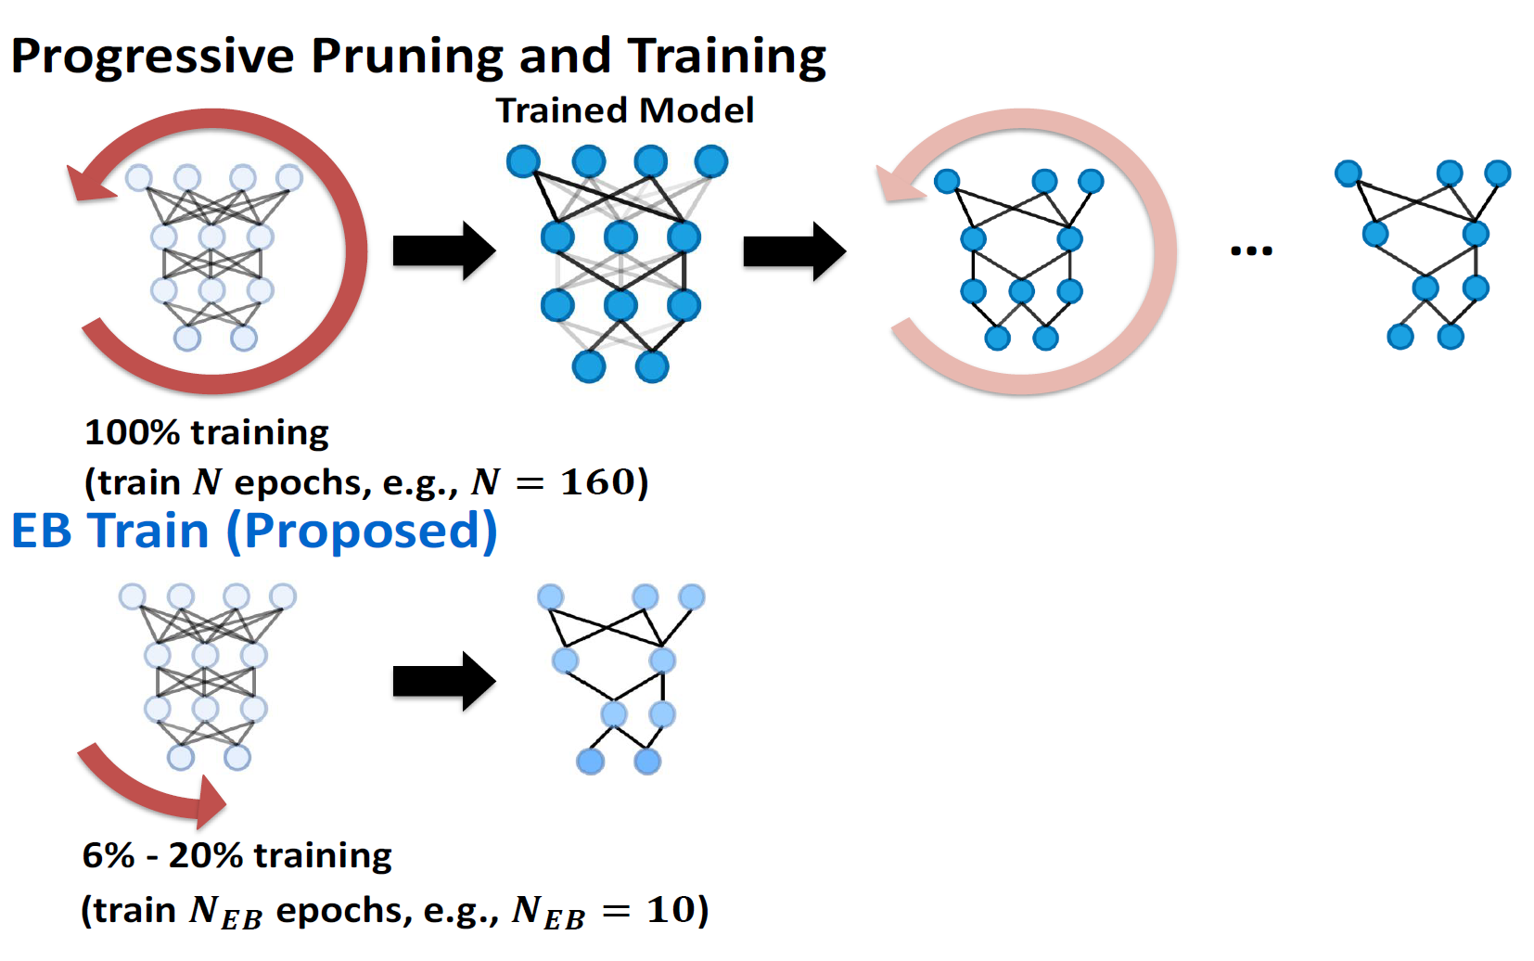
Drawing Early-Bird Tickets
ICLR 2020
Notes:
用的是结构化剪枝，去除整个channel

Slide 21
Drawing Early-Bird Tickets
Find EB via Iterative Pruning + Late Resetting
ICLR 2020

Slide 22
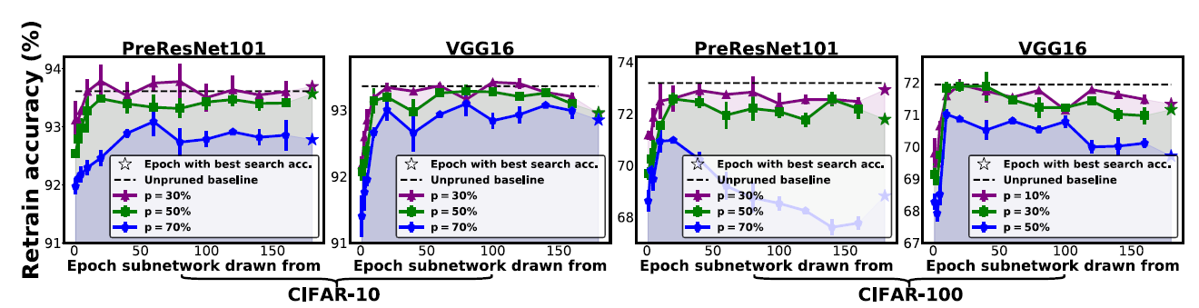
Drawing Early-Bird Tickets
ICLR 2020
Notes:
50%sparsity的EB一般可以和原始模型相当
EB比rewind to 0的WT好，也比传统Pruning好（没有rewind）

Slide 23
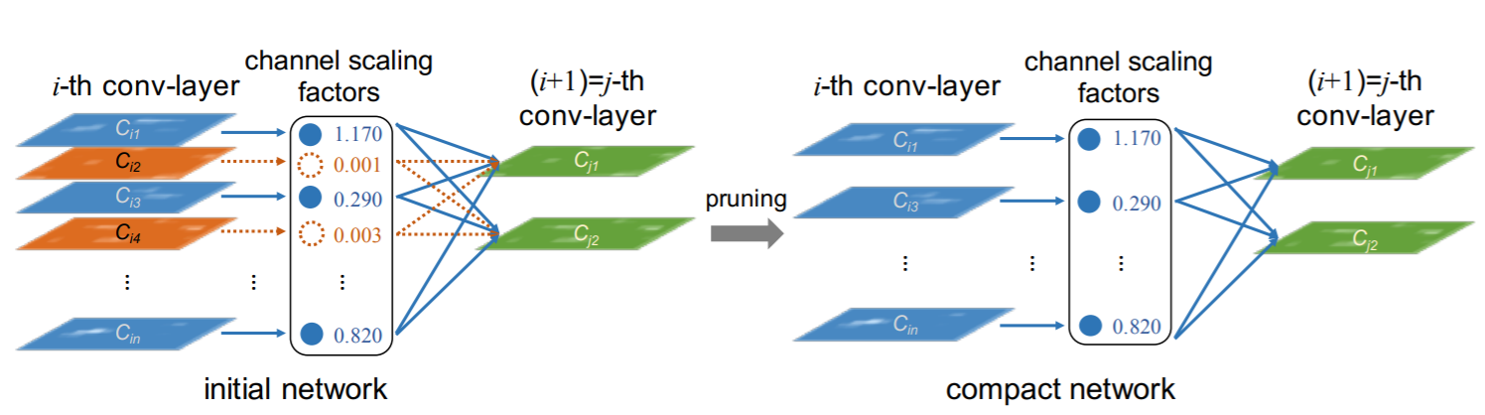
Drawing Early-Bird Tickets
Scaling Factor-based Pruning Mask
ICLR 2020
Notes:
用BN中对每个channel的scaling factor来决定channel重要性

Slide 24
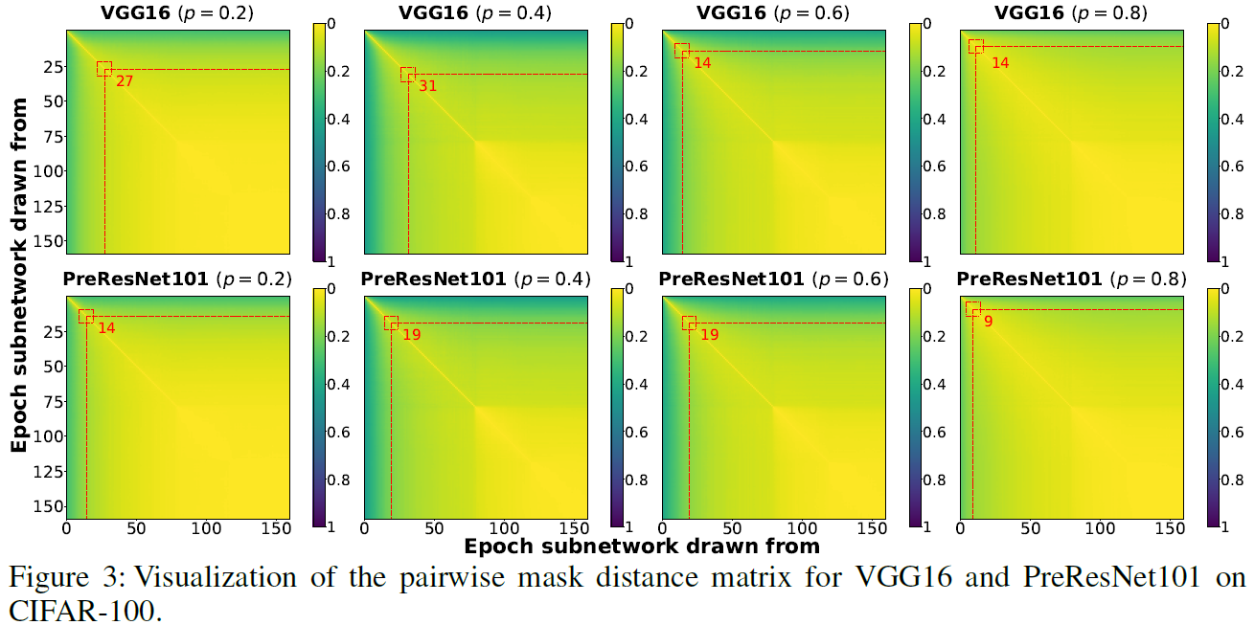
Drawing Early-Bird Tickets
Distance between Masks from different Epochs
ICLR 2020
Notes:
Hamming distance

Slide 25
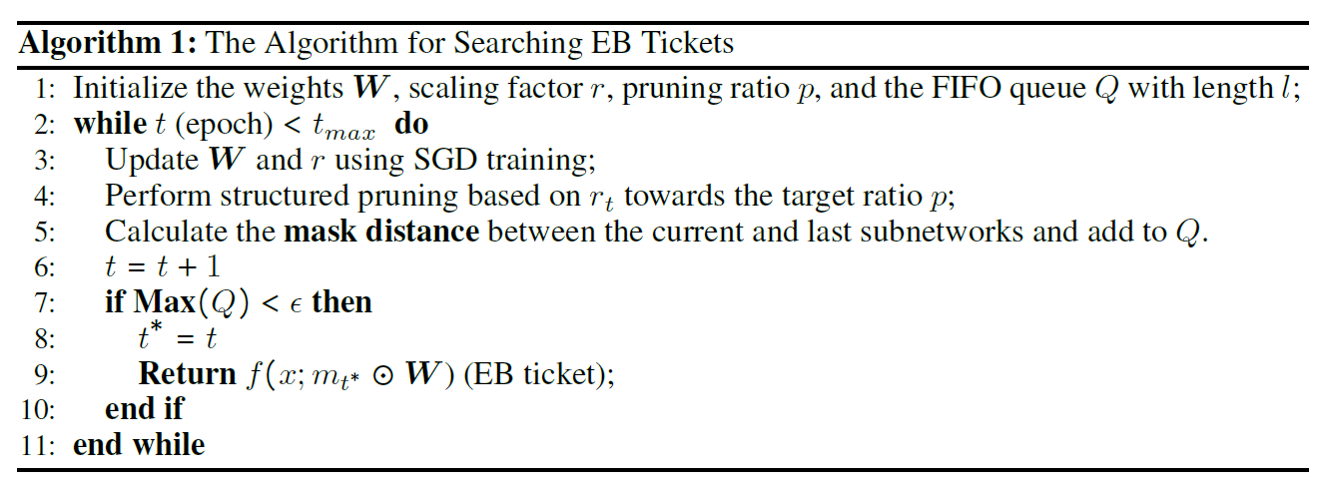
Drawing Early-Bird Tickets
Find EB Using Mask Distance
ICLR 2020
Notes:
Hamming distance

Slide 26
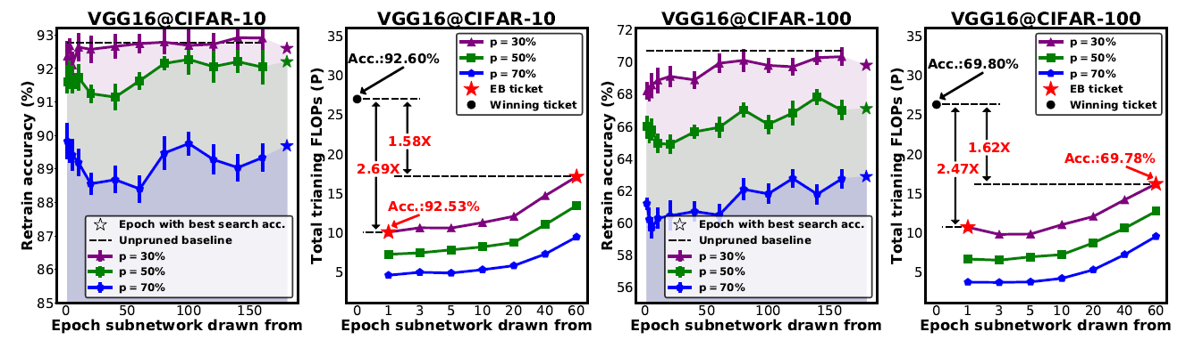
Drawing Early-Bird Tickets
More Efficient Training
ICLR 2020

Slide 27
Research Subfields
The Lottery Ticket Hypothesis
LT in larger models
Speedup Training
LT in other models(GANs, RL, GNN)
Understanding LT
Find winning tickets efficiently
Transfer winning tickets

Slide 28
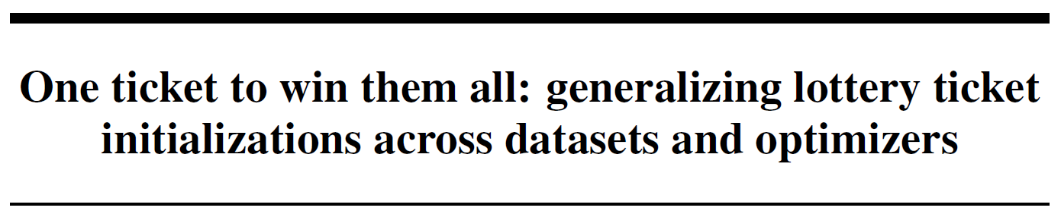
One ticket to win them all
Target Task1
Find Winning Tickets
Transfer Winning Tickets
Source Task
Target Task2
Target Task3
NeurIPS 2019

Slide 29
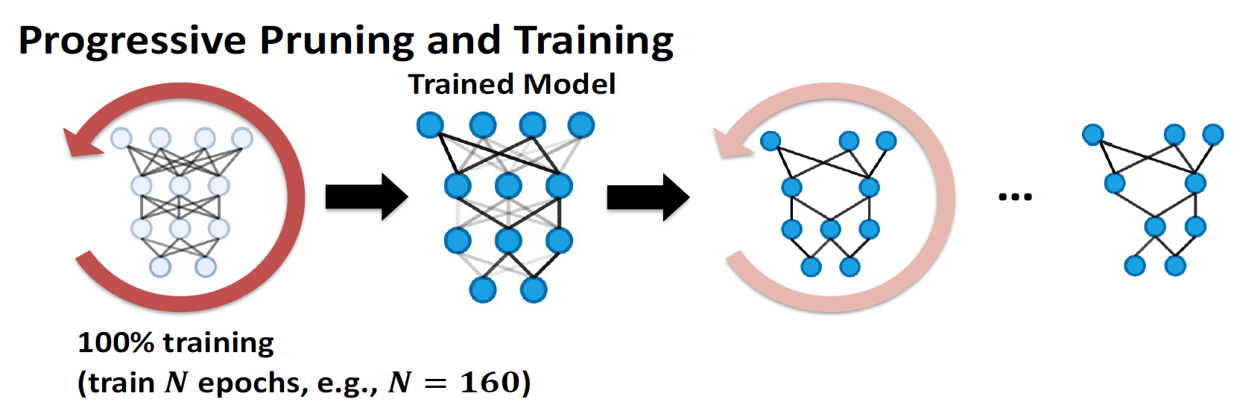
One ticket to win them all
Find Wining Tickets
Iterative Pruning:基于magnitude的unstructured pruning，每个iteration减少20%的weight。
Late Resetting: 每次pruning后，不将weight重置到初始化，而是到某个early training stage。
Global Pruning: 整个模型的weight一起比较重要性，而不是每层内的weight单独比较。
Random Tickets: Pruning mask随机，weight value也随机。
Models: VGG19, ResNet50。
NeurIPS 2019

Slide 30
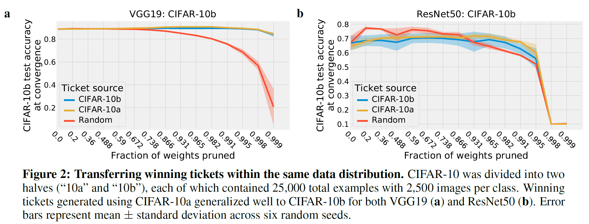
One ticket to win them all
Transfer within Same Data Distribution
NeurIPS 2019

Slide 31
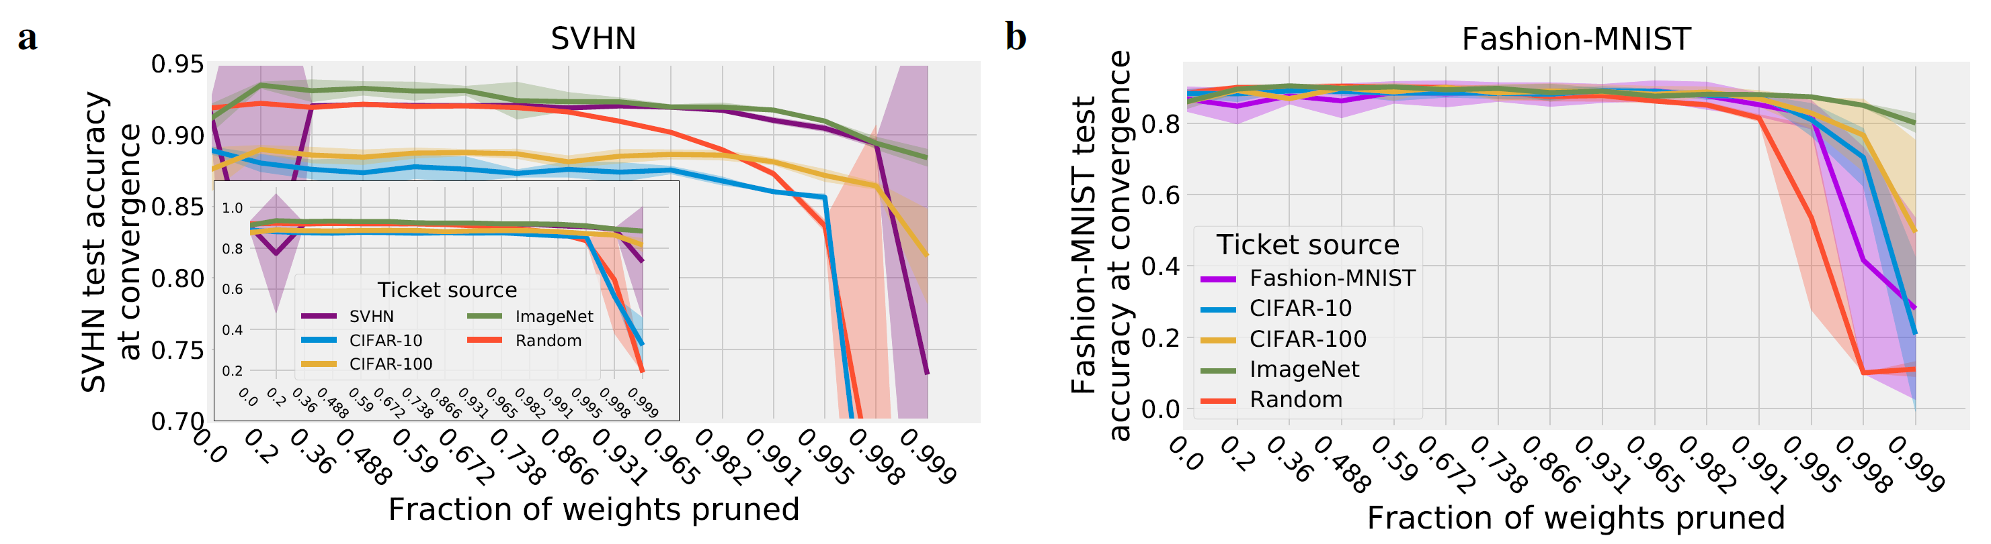
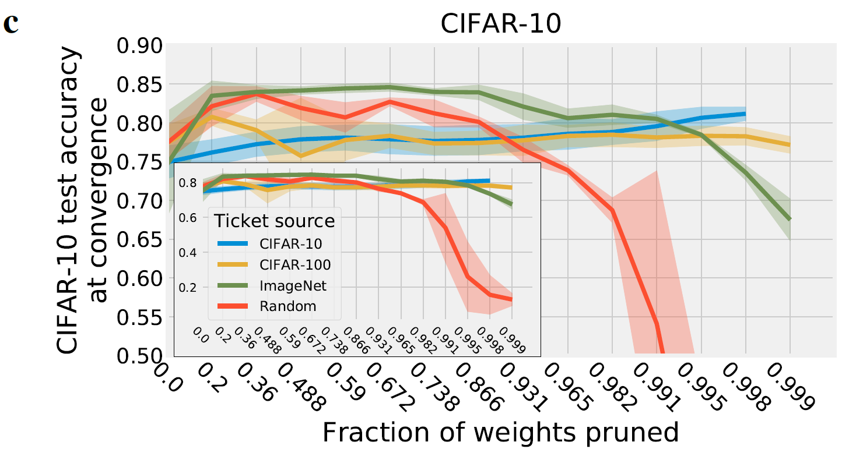
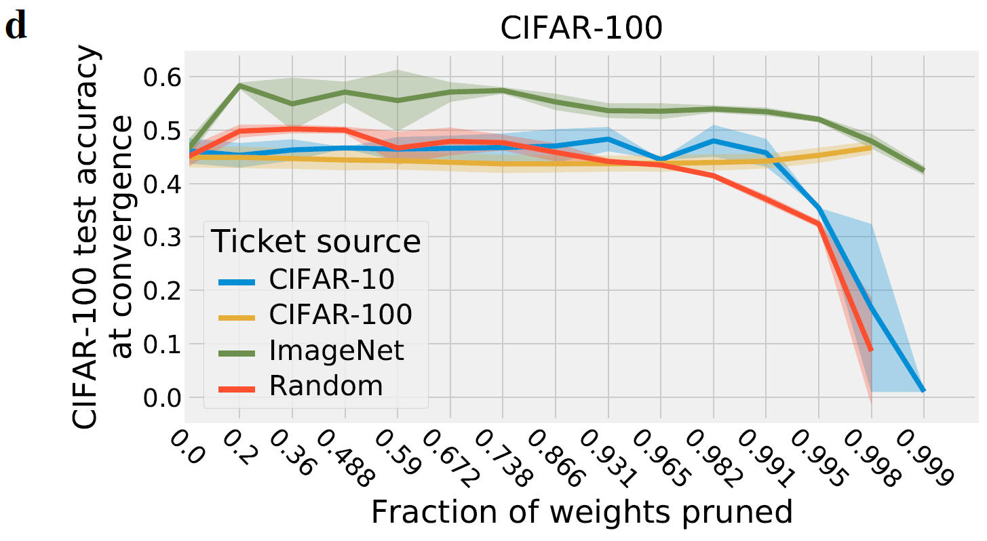
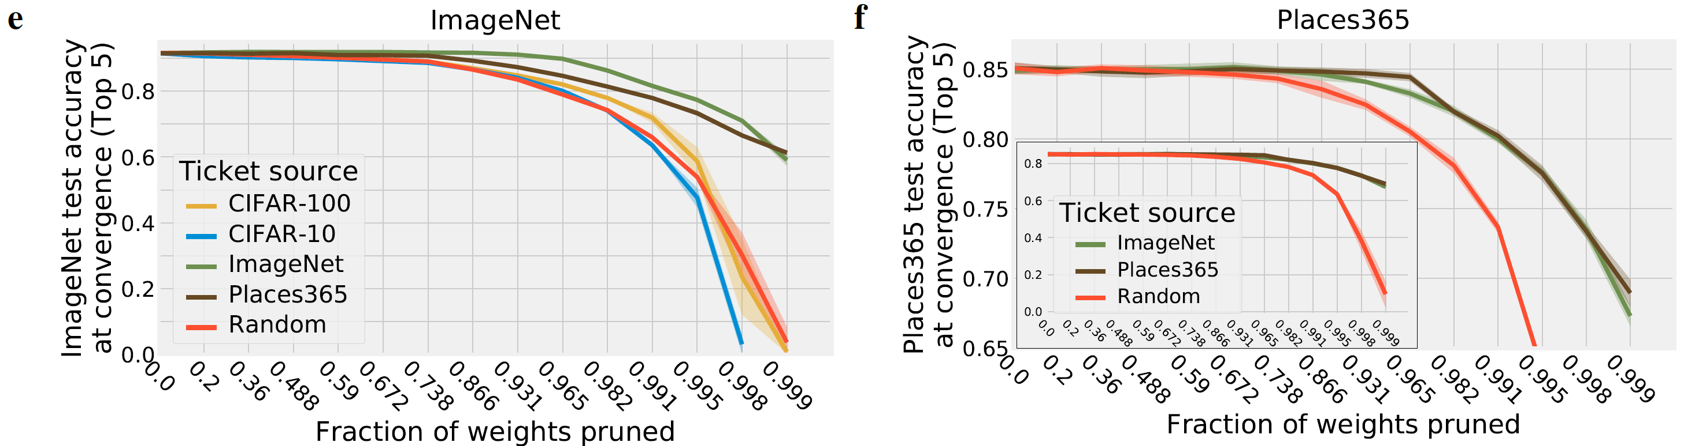
One ticket to win them all
Transfer across Datasets
NeurIPS 2019
Notes:
1、source为ImageNet这样的大数据集时，WT可以迁移到其他数据集。
2、取得和target dataset上找到的WT差不多的效果

Slide 32
One ticket to win them all
Limitations & Solutions
Iterative pruning is still time-consuming.
Only transfer between related tasks (data domain, task type).
Fixed model architecture.
Target task WT sometimes outperforms transferred WT.
NeurIPS 2019

Slide 33
One ticket to win them all
Limitations & Solutions
Iterative pruning is still time-consuming.
Early-bird Tickets,
Pruning at initialization
Only transfer between related tasks (data domain, task type).
Fixed model architecture.
Target task WT sometimes outperforms transferred WT.
NeurIPS 2019

Slide 34
One ticket to win them all
Limitations & Solutions
Iterative pruning is still time-consuming.
Early-bird Tickets,
Pruning at initialization
Only transfer between related tasks (data domain, task type).
LT in Pre-trained Models
Cross domain Transfer
Fixed model architecture.
Target task WT sometimes outperforms transferred WT.
NeurIPS 2019
Notes:
不同任务之间transfer需要考虑task type和data domain的影响，而PTM不需要做这些选择

Slide 35
One ticket to win them all
Limitations & Solutions
Iterative pruning is still time-consuming.
Early-bird Tickets,
Pruning at initialization
Only transfer between related tasks (data domain, task type).
LT in Pre-trained Models
Cross domain Transfer
Fixed model architecture.
Transfer WT across different architectures
Target task WT sometimes outperforms transferred WT.
NeurIPS 2019

Slide 36
One ticket to win them all
Limitations & Solutions
Iterative pruning is still time-consuming.
Early-bird Tickets,
Pruning at initialization
Only transfer between related tasks (data domain, task type).
LT in Pre-trained Models
Cross domain Transfer
Fixed model architecture.
Transfer WT across different architectures
Target task WT sometimes outperforms transferred WT.
Task-adaptive WT
NeurIPS 2019

Slide 37
One ticket to win them all
Limitations & Solutions
Iterative pruning is still time-consuming.
Early-bird Tickets
Pruning at initialization
Only transfer between related tasks (data domain, task type).
LT in Pre-trained Models
Cross domain Transfer
Fixed model architecture.
Transfer WT across different architectures
Target task WT sometimes outperforms transferred WT.
Task-adaptive WT
NeurIPS 2019

Slide 38
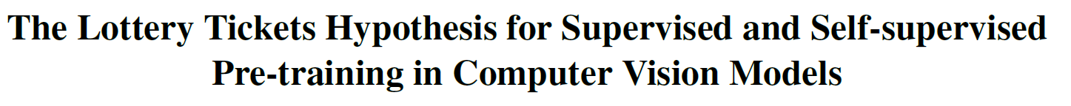
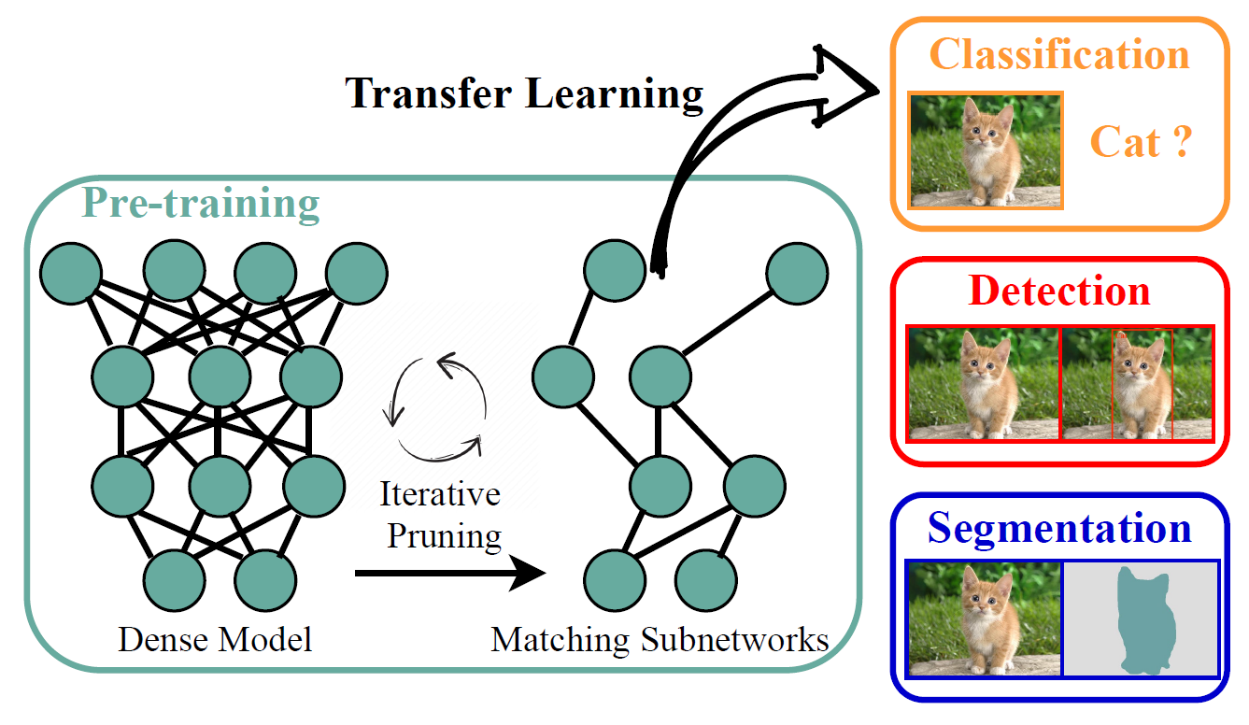
LT for Pre-training in CV Models
CVPR 2021
Notes:
PTM和下游任务different in both task and domain
Obtain positive results

Slide 39
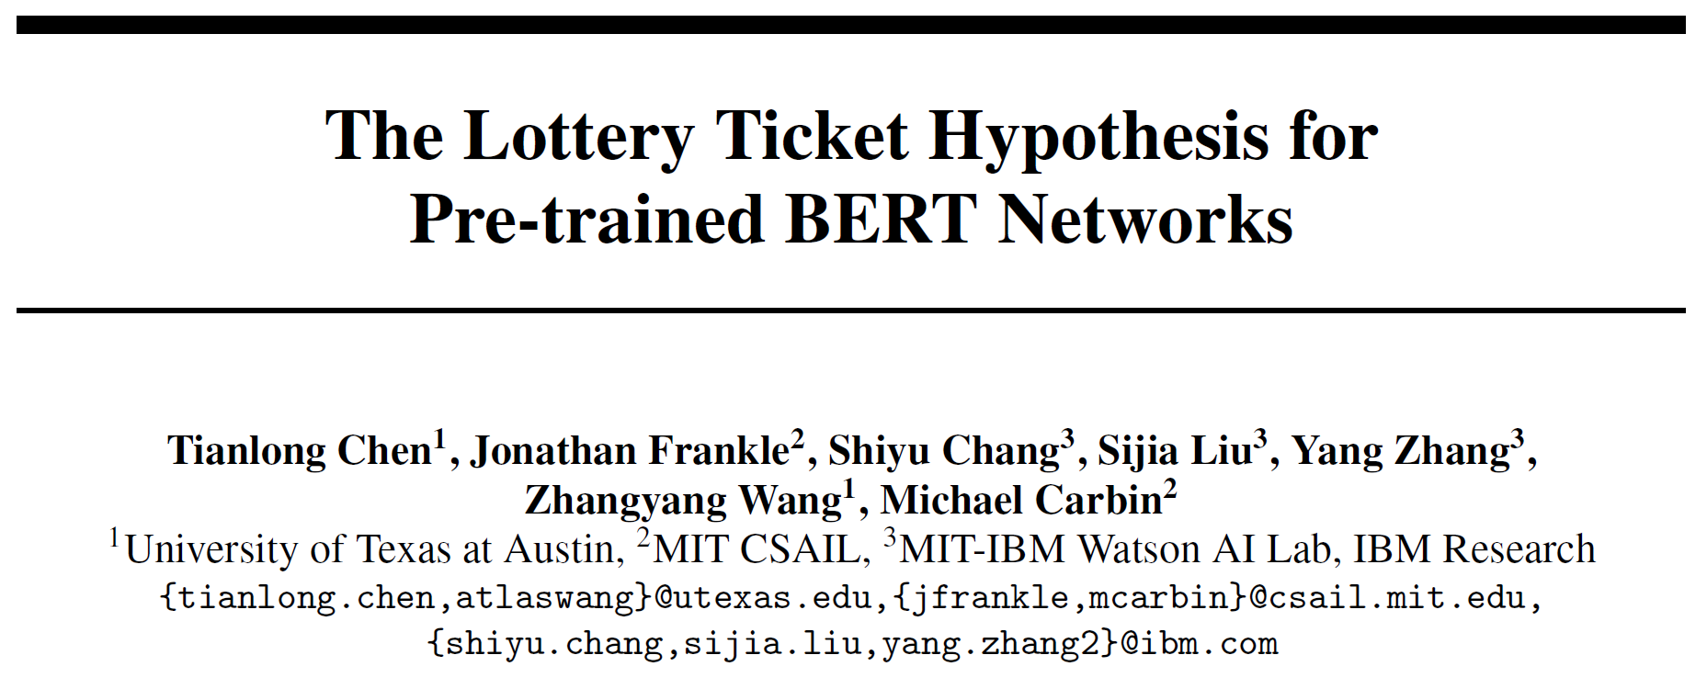
LT for Pre-trained BERT
NeurIPS 2020

Slide 40
LT for Pre-trained BERT
Find Winning Tickets via Iterative Pruning
NeurIPS 2020

Slide 41
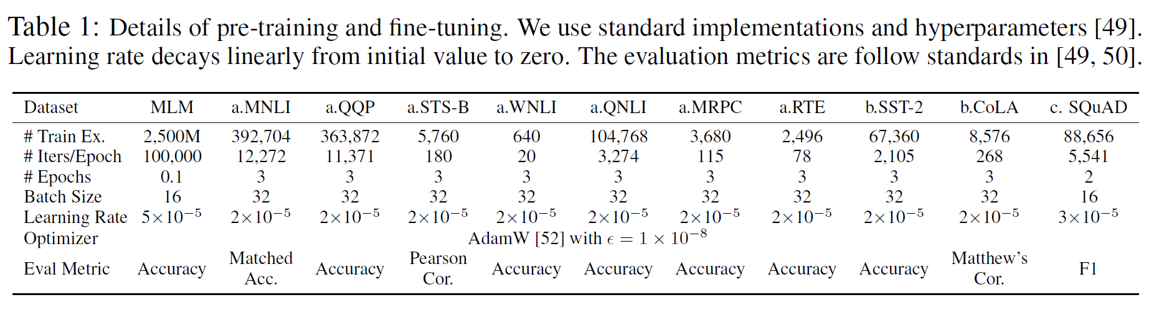
LT for Pre-trained BERT
Find Winning Tickets via Iterative Pruning
每次训练用160,000条数据
NeurIPS 2020
Notes:
Iterative pruning每一轮训练/Pruning的训练超参数

Slide 42
LT for Pre-trained BERT
Winning Ticket
Random Ticket
Random Init
Random Shuffle
NeurIPS 2020

Slide 43
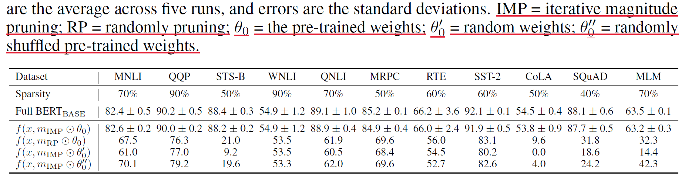
LT for Pre-trained BERT
Winning Tickets in Downstream Tasks
NeurIPS 2020

Slide 44
LT for Pre-trained BERT
Winning Tickets in Downstream Tasks
NeurIPS 2020
Notes:
WT和Full network的效果差在一个standard deviation内

Slide 45
LT for Pre-trained BERT
Winning Tickets in Downstream Tasks
NeurIPS 2020
Notes:
所有类型的random ticket都远不如WT，说明达到了Nontrivial sparsity

Slide 46
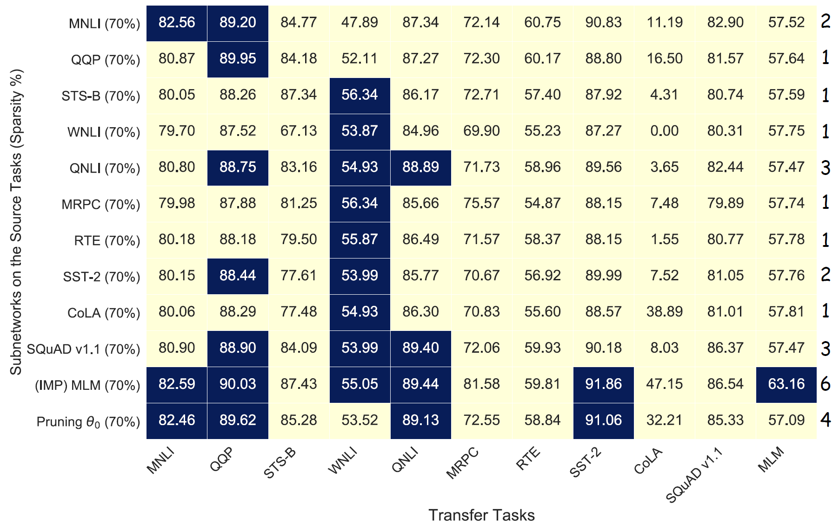
LT for Pre-trained BERT
Transfer Winning Tickets
NeurIPS 2020
Notes:
黑框代表winning tickets (和dense network效果在一个标准差以内)
下游任务之间迁移效果不好，MLM迁移效果不错

Slide 47
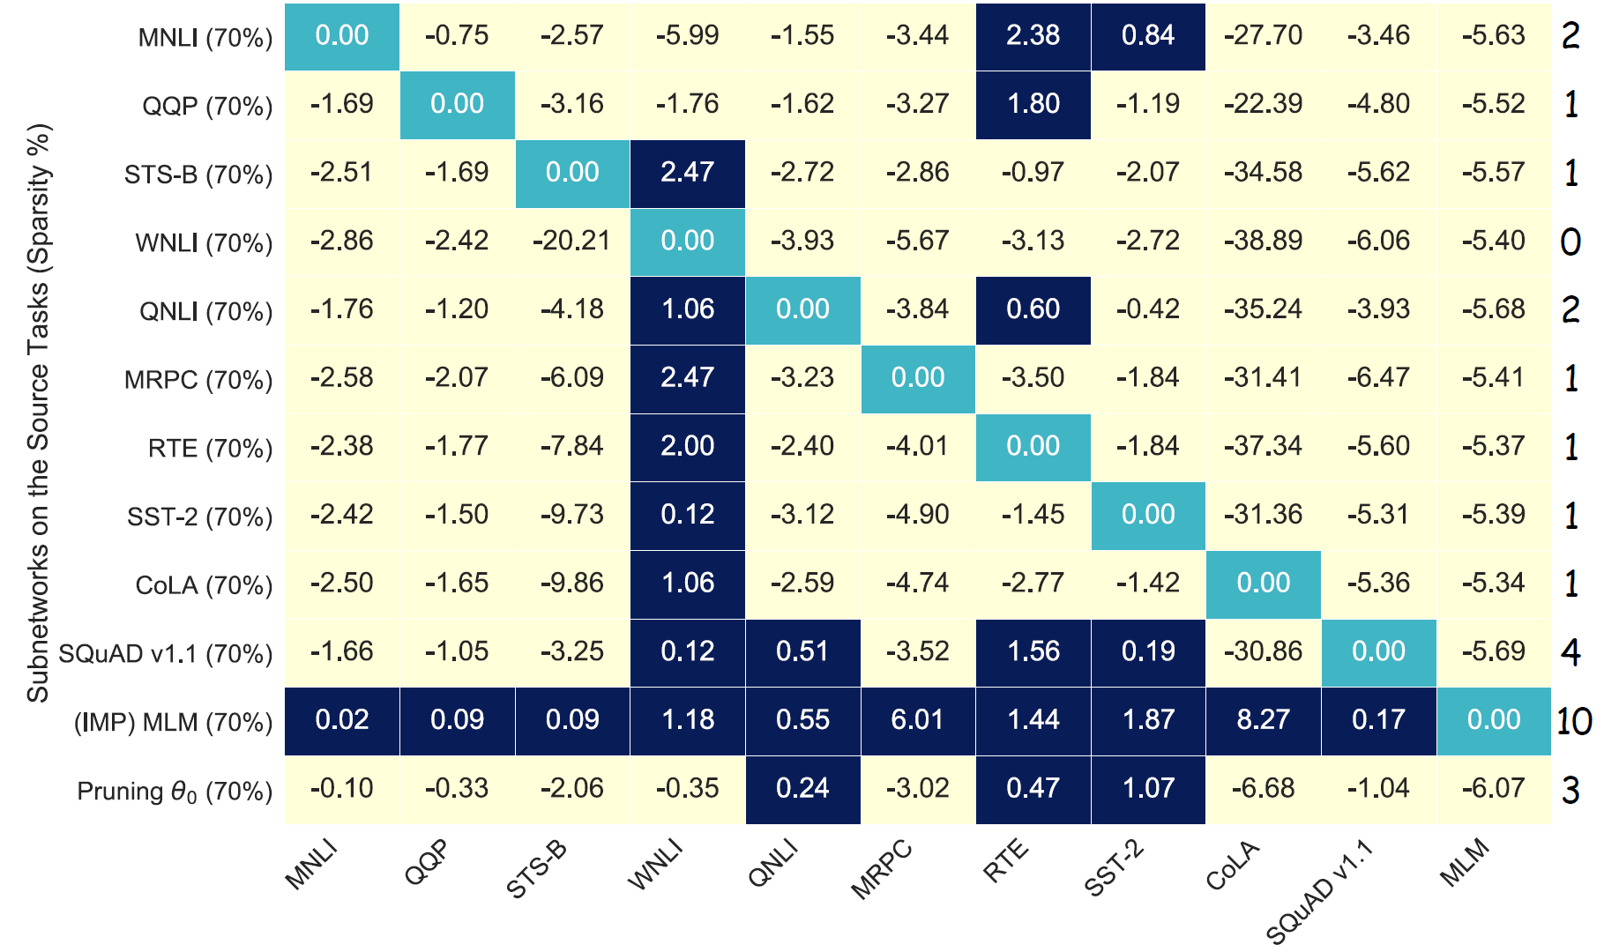
LT for Pre-trained BERT
Transferred WT vs Target Task WT
NeurIPS 2020
Notes:
直接Pruning /sita_{0}也比下游任务之间迁移的最好结果好，说明将Pre-training作为source task比下游任务更加方便且有效

Slide 48
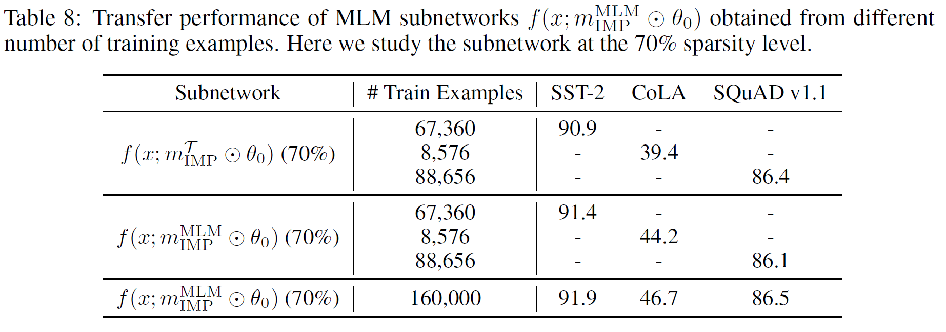
LT for Pre-trained BERT
The Effect of Training Data Size
(IMP) MLM一轮的训练数据
下游任务的训练数据
NeurIPS 2020

Slide 49
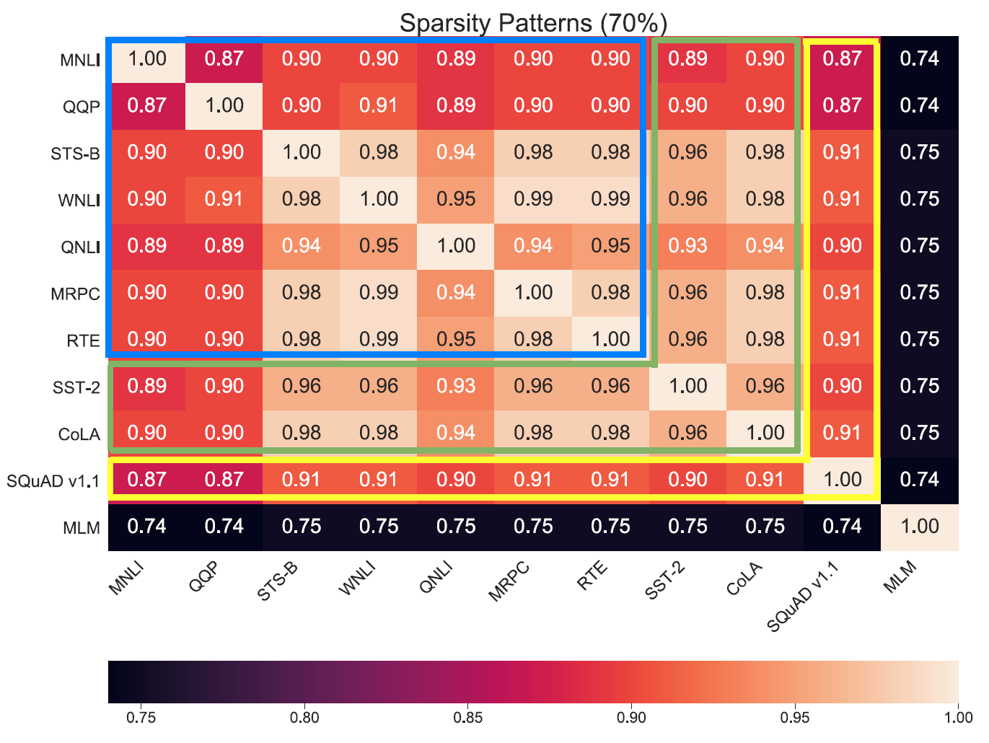
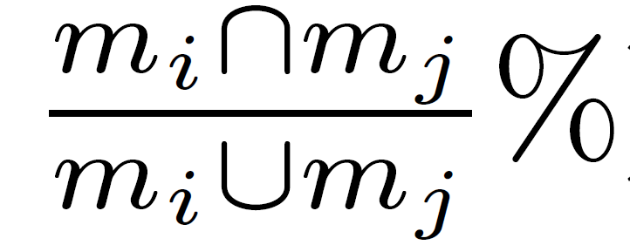
LT for Pre-trained BERT
WT Similarity between Different Tasks
Mask Similarity:
NeurIPS 2020

Slide 50
LT for Pre-trained BERT
New Paradigm to Use BERT
Pre-training
(IMP) MLM
Fine-tuning
NeurIPS 2020

Slide 51
(Recall) One ticket to win them all
Limitations & Solutions
Iterative pruning is still time-consuming.
Early-bird Tickets
Pruning at initialization
Only transfer between related tasks (data domain, task type).
LT in Pre-trained Models
Cross domain Transfer
Fixed model architecture.
Transfer WT across different architectures
Target task WT sometimes outperforms transferred WT.
Task-adaptive WT transfer
NeurIPS 2019
Notes:
直觉上不同任务需要的特征还是有区别
虽然前文（IMP）MLM已经在所有下游任务上超过了task-specific WT，但是只是iterative pruning。如果更加有效地利用任务信息，可以找出更准确的Task-specific WT

Slide 52
Task-Agnostic WT vs Task-Adaptive WT
Pre-trained Model
Pre-trained Model
Task
Information
Task1 WT
Task2 WT
Task3 WT
Task-Agnostic WT
Target Task1
Target Task2
Target Task3
Target Task1
Target Task2
Target Task3

Slide 53
Task-Agnostic WT vs Task-Adaptive WT
Task-Agnostic WT
Task-Adaptive WT
Strength:
Universal transferability
Weakness:
Lower pruning ratio
Strength:
Higher pruning ratio
Weakness:
Require task information

Slide 54
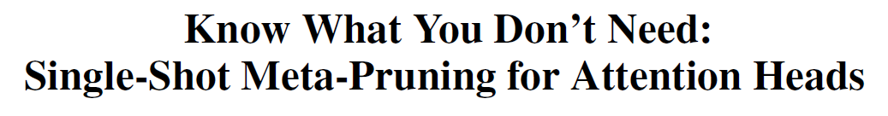
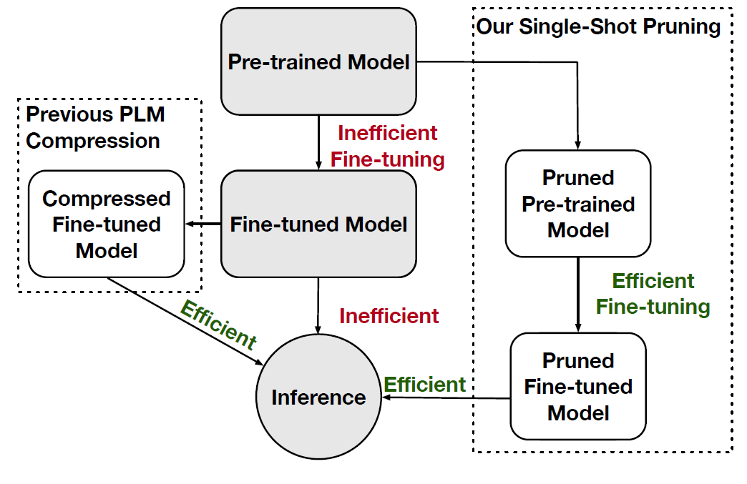
Task-Adaptive WT
Arxiv preprint 2020

Slide 55
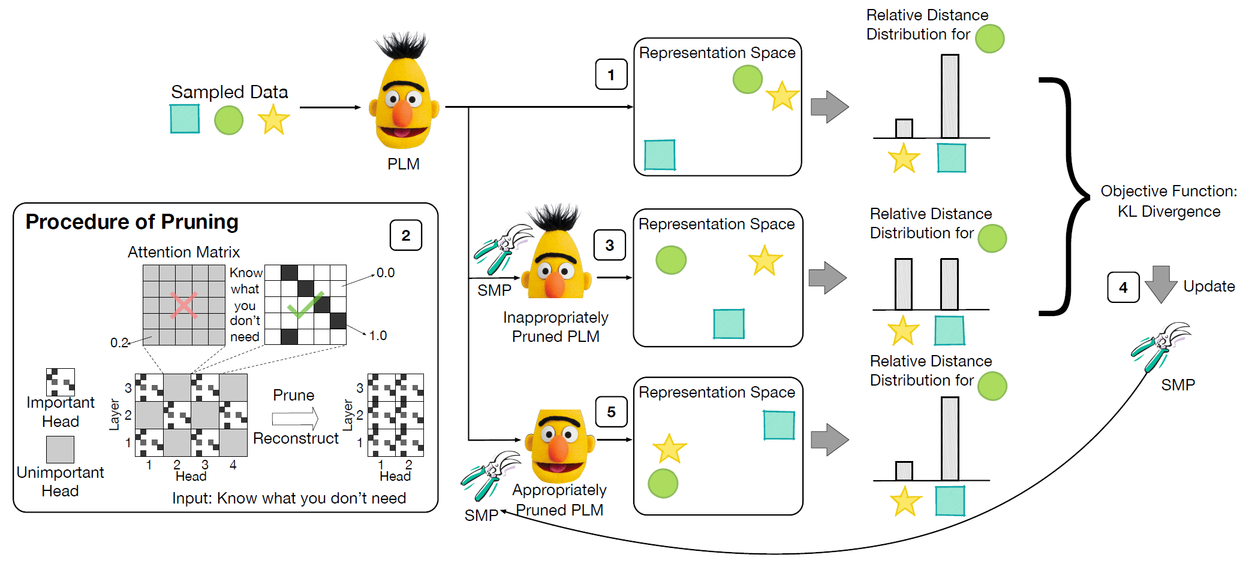
Task-Adaptive WT
Meta-Learning to Prune Attention Heads
Arxiv preprint 2020

Slide 56
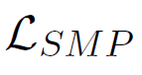
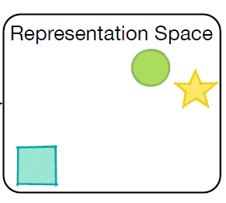
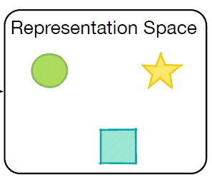
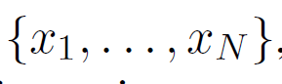
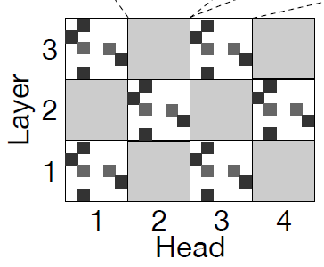
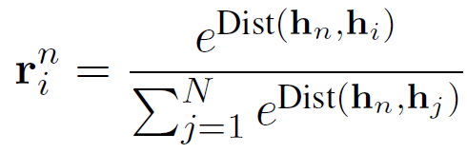
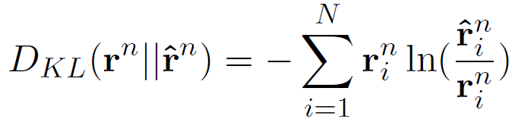
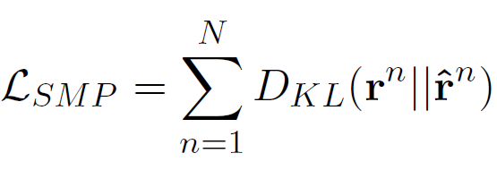
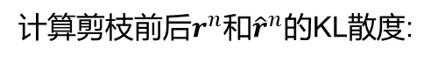
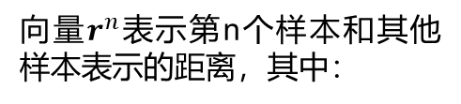
Task-Adaptive WT
Training CNN Meta-Learner
Meta-objective目标是保持pruning前后模型表示空间不变。
假设有N个样本
向量$r^{n}$表示第n个样本和其他样本表示的距离，其中：
attention maps
Pruned BERT
BERT
CNN meta-learner
计算剪枝前后$r^{n}$和${\hat{r}}^{n}$的KL散度:
BERT Forward Pass
A batch of data
Pruning
最终Meta-objective为:
Pruned BERT
Forward Pass
Task1
Task2
Task3
Gradient Update
Source Tasks Datasets
Freeze
Arxiv preprint 2020
Trainable

Slide 57
Task-Adaptive WT
Pruning with CNN Meta-Learner
Fine-tuning
attention maps
Pruned BERT
BERT
CNN meta-learner
A batch of data
Target Task
Dataset
BERT Forward Pass
Pruning
Arxiv preprint 2020

Slide 58
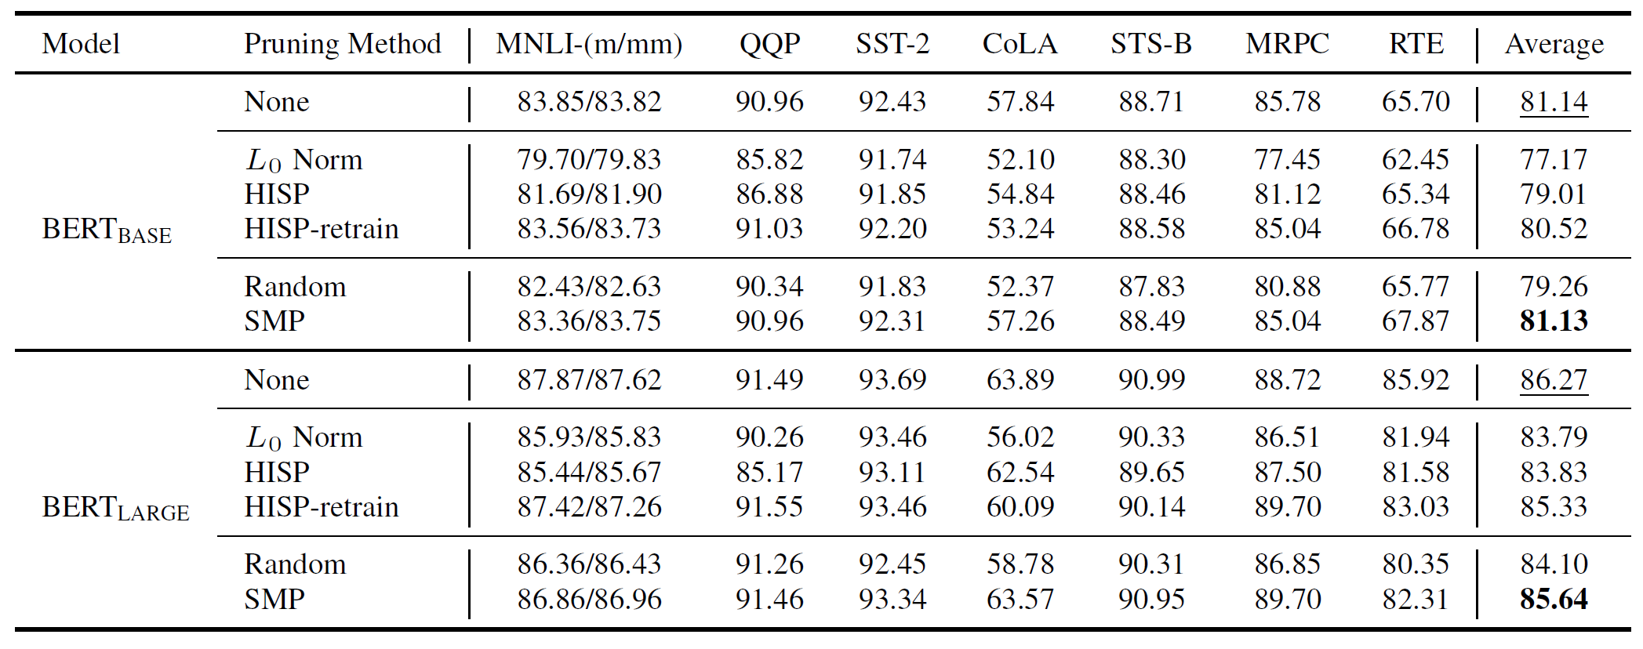
Task-Adaptive WT
Results on seven tasks in GLUE (%)
Arxiv preprint 2020
Notes:
HISP基于一阶 Taylor 展开，prune after fine-tuning
L0用一个gate控制模型输出，并加上L0正则化
全部结果都是去除50% attention heads

Slide 59

Task-Adaptive WT
Results on Memory & Time Efficiency
Arxiv preprint 2020

Slide 60

Task-Adaptive WT
AAAI 2021
Notes:
LT和Task-adaptive WT的思想

Slide 61

Task-Adaptive WT
Overcome Catastrophic Forgetting
AAAI 2021

Slide 62

Task-Adaptive WT
Parameter-Efficiency
Task1
Task2
Task3
AAAI 2021

Slide 63
Task-Adaptive WT
Include Human Knowledge
根据知识选择相关的weight
训练target domain weights (green)
biology domain
medical domain
general domain
AAAI 2021
sports domain

Slide 64




